Slide 1
WILLIAMS LIMITED STRESS ANALYSIS
BY AARON OTOMOFA

Slide 2
Background
Williams Limited is a company located in the urban part of Lagos, Nigeria. They specialize in the production and sales of polythene bags of Different sizes, colors and designs. This project was carried out to study the stress pattern noticed in the workers, and how best it can be managed. The project aims to help improve the workers productivity and also help them better maintain a healthy living.

Slide 3
Data description
Data source:
Title: Stress levels
Provided by: The Human Resource department of Williams ltd
Date: August, 2024
Format: CSV.

Slide 4
Data description cont.
Data collection: Data was collected through surveys, and monitoring systems.
Data characteristics: The dataset consists of 18 columns and 5000 rows.
Then, during data cleaning, extra 4 columns were created for efficient analysis. The columns include;
Age int
Age Group
Stress category
Test Time category

Slide 5
Problem statement
This project aims to analyze the level of stress that employees of the company undergo, the effect on their health (both physically and emotionally) and also provide findings and recommendations that can help the company make better informed decisions on how best to manage stress and help the workers maintain a healthy lifestyle, and overall improve productivity.

Slide 6
Objectives
To Determine the most common physical symptom, and the effect of physical symptoms on the employees.
To Determine the most common Emotional symptom, and the effect of physical symptoms on the employees.
To investigate the various stress sources and their effect on the workers.
To uncover the effect of the severity of stress on the employees.
To understand the most preferred coping mechanism of the workers and the efficiency of the various coping mechanism.

Slide 7
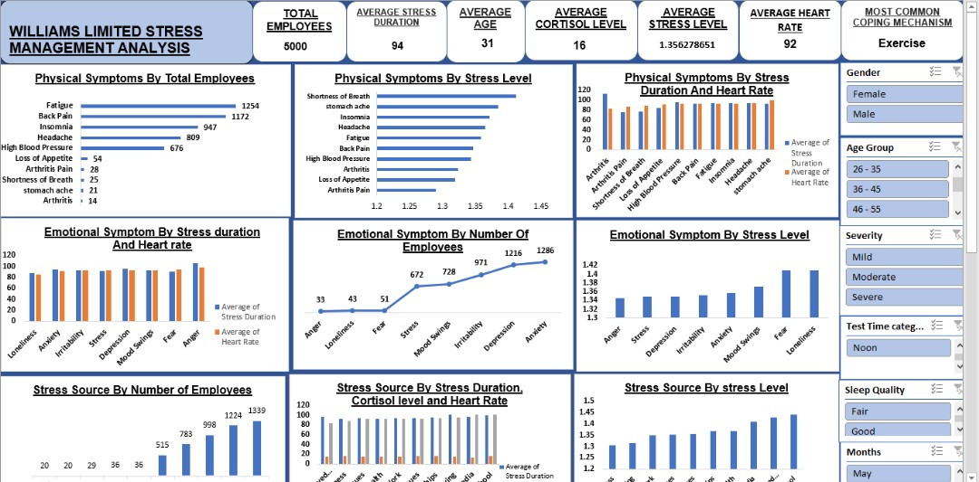
Dashboard overview

Slide 8
Employee Details
Total employee: 5000
The overall Average heart rate = 92
The overall Average stress level = 1.3562787
The Average age of the employees = 31
The Average cortisol level = 16
The most common coping mechanism = Exercise.
Age group | Male | Female | total number Of employees
17 - 25 | 1093 | 999 | 2092
26 - 35 | 795 | 801 | 1596
36 - 45 | 285 | 270 | 555
46 - 55 | 190 | 172 | 362
56 - 65 | 126 | 113 | 239
66 - 75 | 62 | 57 | 119
76 - 79 | 20 | 17 | 37
Total | 2571 | 2429 | 5000

Slide 9
ANALYSIS

Slide 10


Slide 11
Insights
The physical symptoms experienced by the employees are mainly as a result of compounded stress. E.g. back pain experienced by young employees, compounding into arthritis when they get older.
The amount of stress each employee can take on without breaking down with a physical or emotional symptom reduces by age. i.e. young employees can handle more stress than the older employees.
Major physical stress is fatigue and back pain, while emotional stress is anxiety and depression.
Physical symptoms like Arthritis is mainly noticeable in employees above 55 years of age.
A correlation analysis done on the stress level, cortisol level and the heart rate of the employees shows that they are all positively correlated with a correlation of over +0.3, which shows a low but positive correlation.

Slide 12
Insights
From the analysis, the major stressor in general was shown to be work. While most young employees suffer from school stress, work, relationships.
Middle-aged employees under go majorly financial issues and family issues while most old/advanced employees suffer from loneliness and health issues.
Although being the least stressor, some employees reported bullying as a stressor they are suffering from.
The most common and effective coping mechanism among young and middle-aged employees are Exercise, meditation, food and therapy. While the most common and efficient amongst advanced/older employees gardening, walking, reading and hobbies.
Sleep quality has a major impact on the stress level score of the employees.
Young and middle-aged employees suffering from severe stress are very prone to high blood pressure and other serious illness if not detected early enough and properly managed.

Slide 13
RECOMMENDATIONS
From the insights above, the following recommendations are suggested;
The organization should also create a proper structure that supports division of labor so as provide a healthy balance as to how much work an individual takes on.
Ensure the checking of the vitals (like stress level, heart rate, blood pressure, etc.) of every employee at regular intervals to spot any health issue early enough and administer the proper care that is needed
Provision of subsidy on gym registration for the employees since exercise is the most efficient coping mechanism.
A mandate to ensure that employees take their physical health(seriously) especially young and middle-aged employees, so as to prevent them from being affected by compounded stress (e.g. back pain and fatigue compounding to become arthritis) when they get older.
A strict law should be placed against bullying of any form as some young employees complained about bullying.

Slide 14
Recommendation cont.
The most common stressor is work and financial issues, hence seminars and workshop should be provided on work-life balance and financial literacy.
Therapy sessions should be provided for employees with signs of depression.
Easy access to food or provision of stipends for food should be made for employees, as this also helps to cope against stress.
Quality sleep should be encouraged among employees, as it helps to reduce their stress levels.
Old/advanced employees should be encouraged to join social clubs (like book clubs or whatever hobbies they choose) of their age brackets or encouraged to spend more time with family as this would help them cope against loneliness.
Instead of gyms, old /advanced employees can be provided with an avenue to practice walking as this also helps them deal with stress.
And lastly, the company should consider reducing the retirement age of the employees.

Slide 15
THANKS

